Slide 1

Lei s ure World Amenities Survey Analysis
Leisure World Resident Survey
“Most and Least Liked Amenities”
September 2025

Slide 2
Sampling: 1. Population ~ 8,500 2. Sample: subset = 502 3. Respondents – 94 4. Response Rate = .1872 or 19% (Database complied from email addresses of LW residents)

Slide 3
Rating Amenities
Satisfaction (1 = Very Dissatisfied, 5 = Very Satisfied)
Importance (1 = Not Important, 5 = Very Important)
Not applicable (Type N/A in Comments)

Slide 4
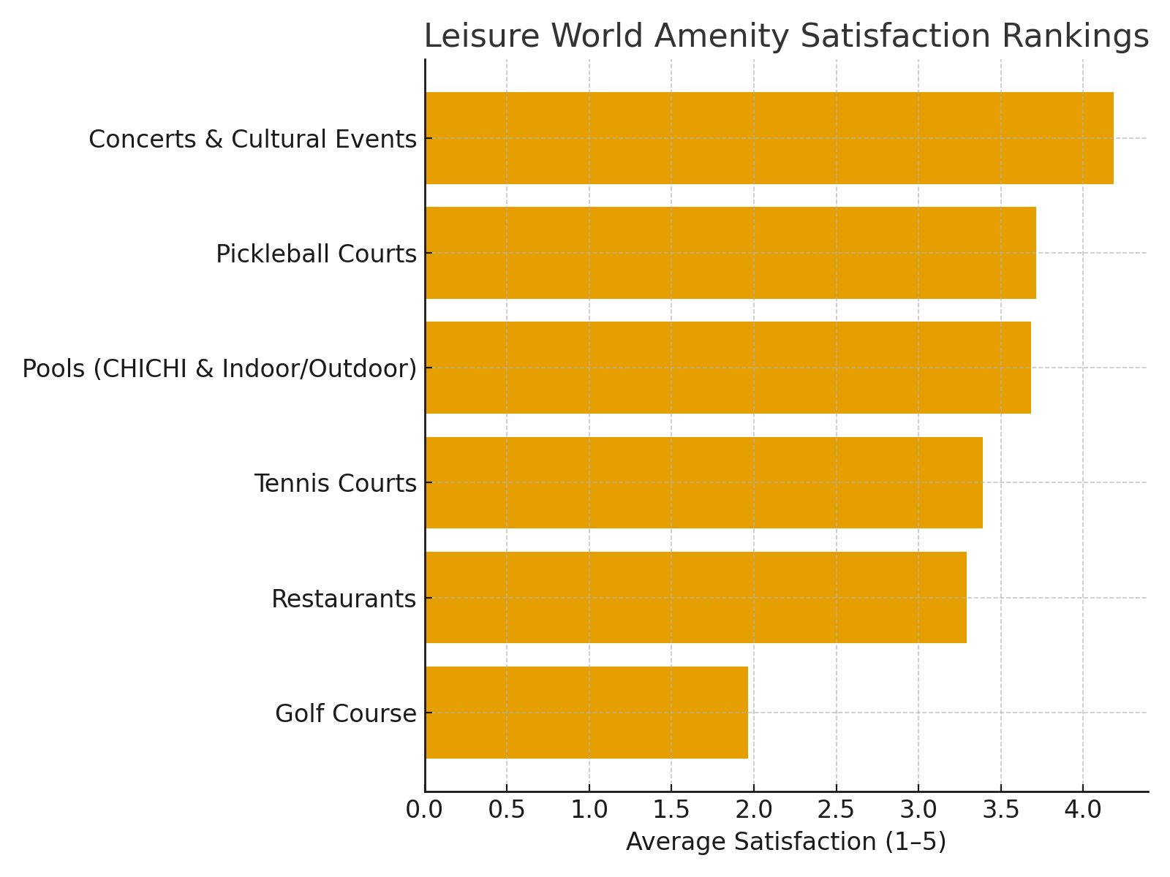
Amenity Satisfaction Rankings

Slide 5
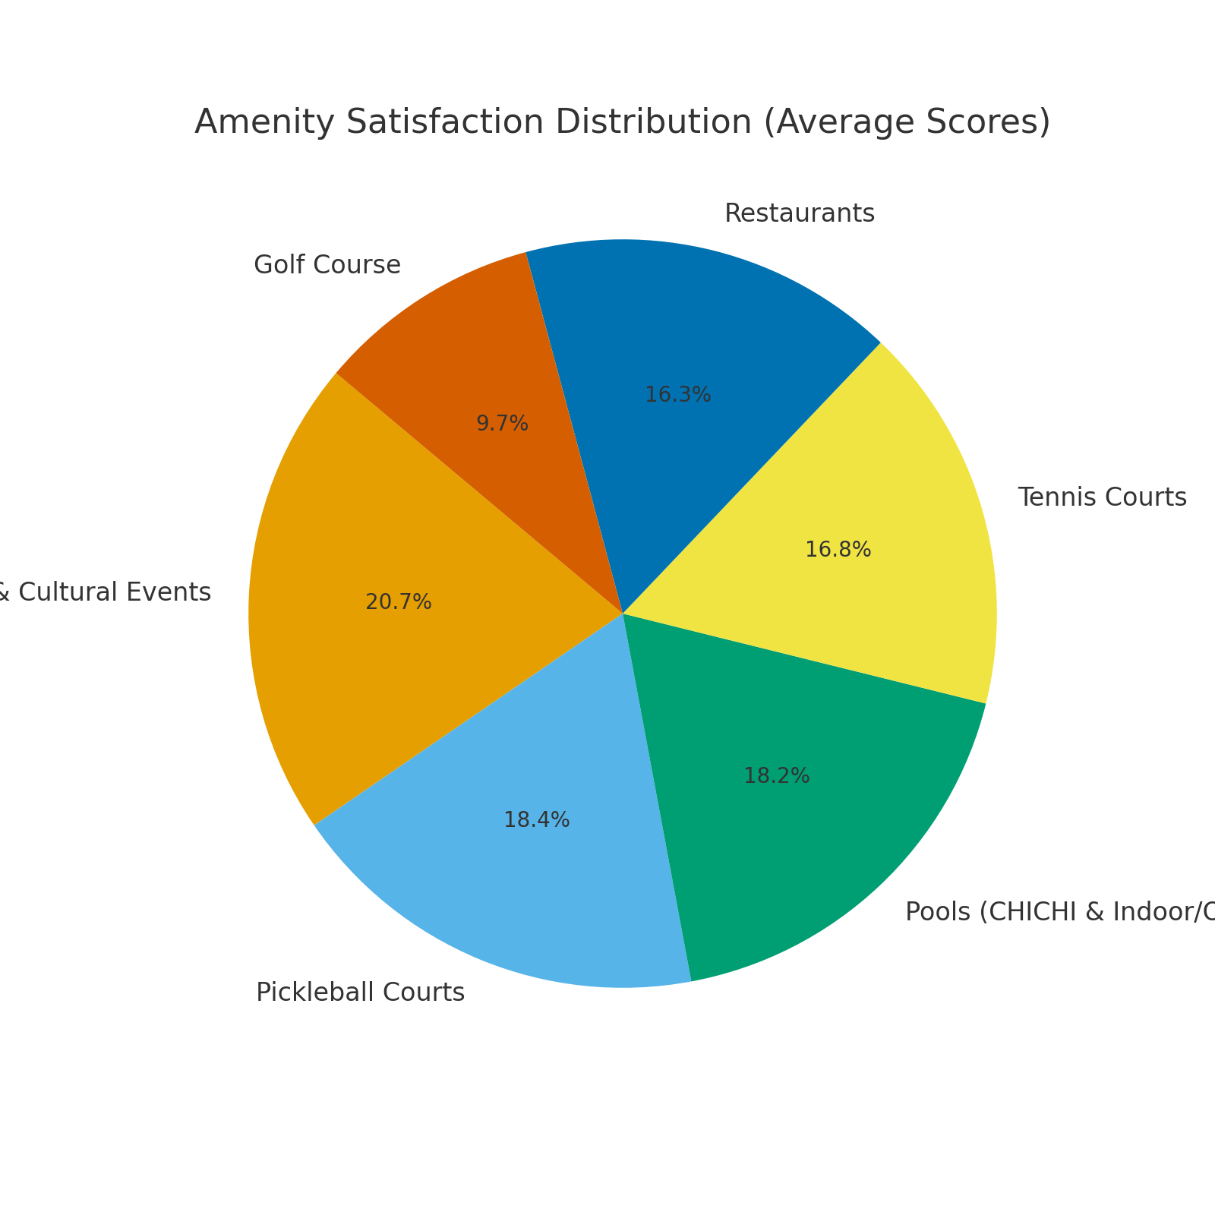
Satisfaction Distribution

Slide 6
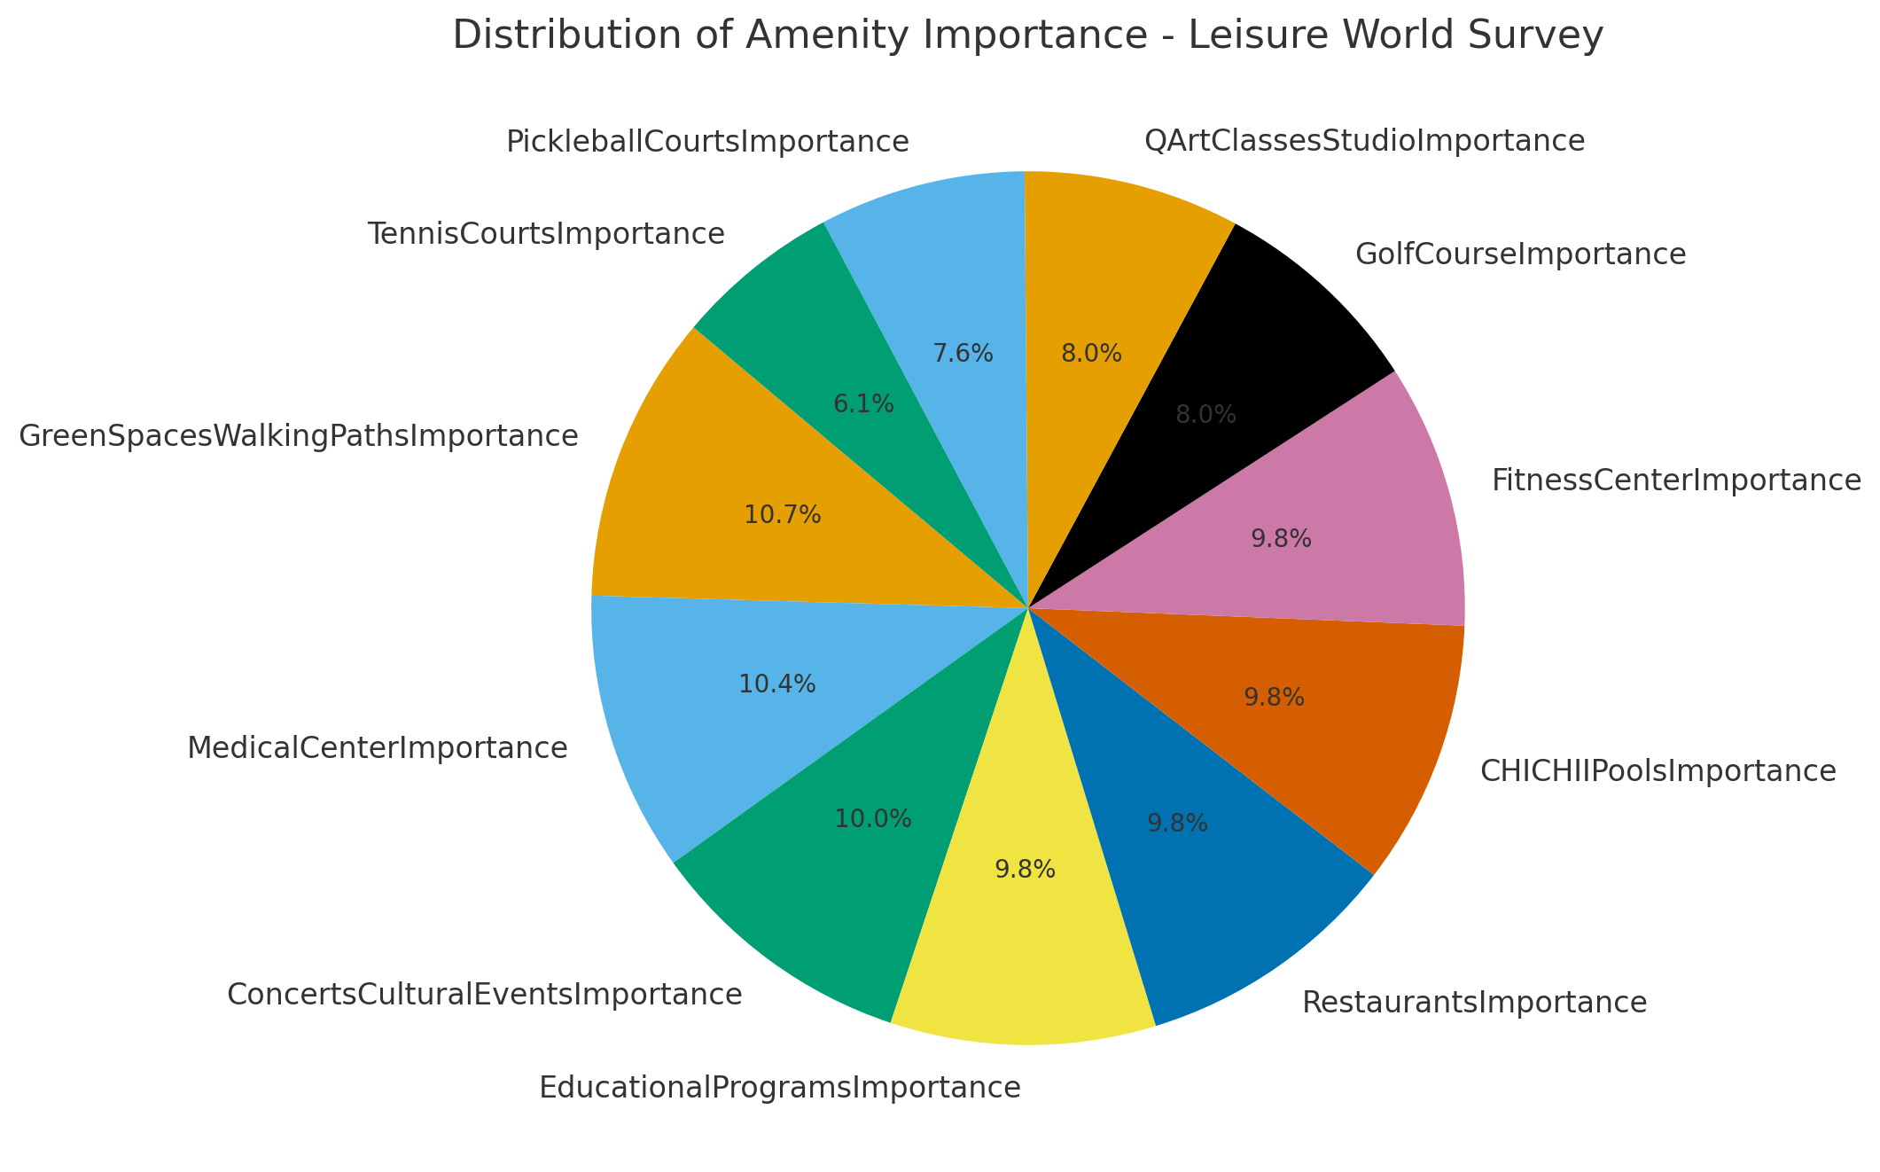
8.0

Slide 7
Text responses from comments:
Restaurants / food service (complaints about quality, variety, and service speed).
Walking paths / green space improvements (maintenance, expansion).
Pools & fitness center (desire for more classes, better scheduling).
Transportation & buses (replacement, reliability).
Entertainment & events (concerts, movies, cultural offerings).
Residents also suggested new amenities, including:
Coffee shop/café
More exercise classes
Expanded art/music opportunities
Better seating areas in restaurants
More trash cans & benches

Slide 8
Key Conclusions
Concerts & Cultural Events are the most liked amenity (avg. 4.2/5).
Golf Course is the least liked amenity (avg. 2.0/5).
Pickleball, Pools, and Tennis show moderate satisfaction.
Restaurants received mixed reviews, highlighting room for improvement.
Focus on strengthening cultural/social programs while reconsidering
the role of the golf course.

